Slide 1


Efficient Learning of Goal-Oriented Push-Grasping Synergy in Clutter
2021 RAL
23.11.06 1st Paper Presentation
20234450 Seokryun Choi
Scalable Graphics, Vision & Robotics Lab
Notes:
Hi today I am going to present ‘efficient learning of goal-oriented push-grasping synergy in clutter’. This paper was published in RAL 2021.

Slide 2
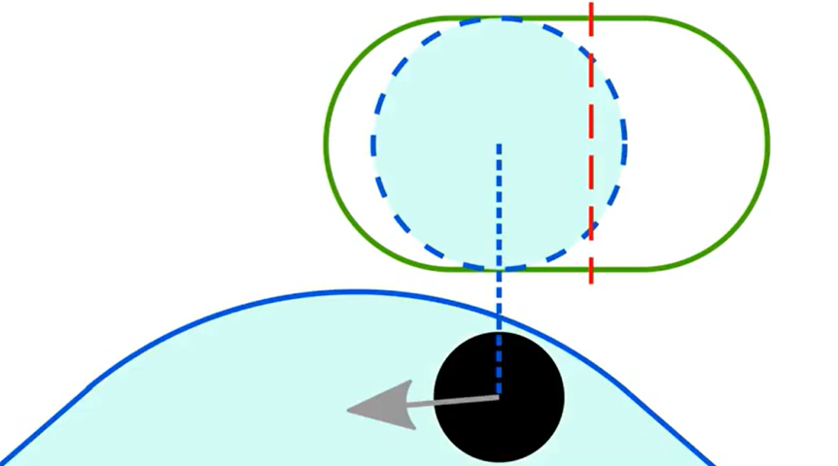
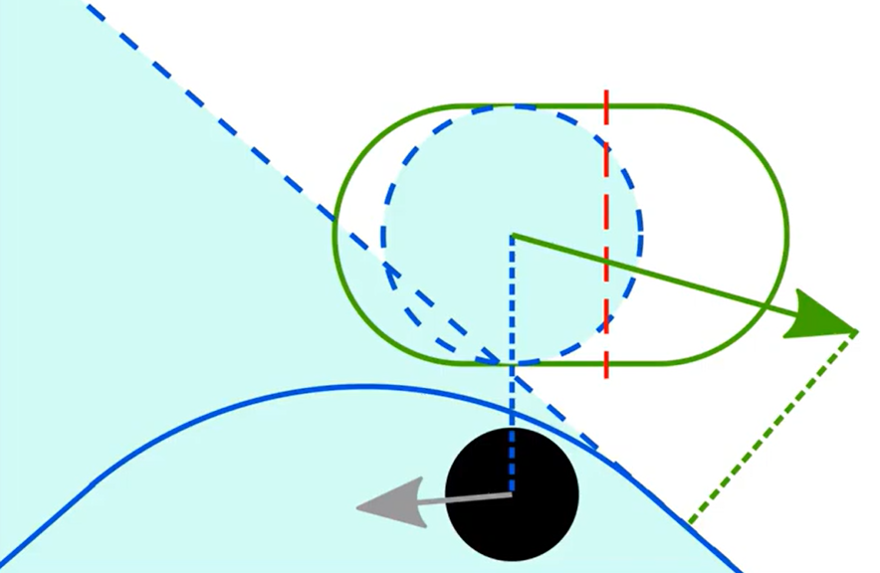
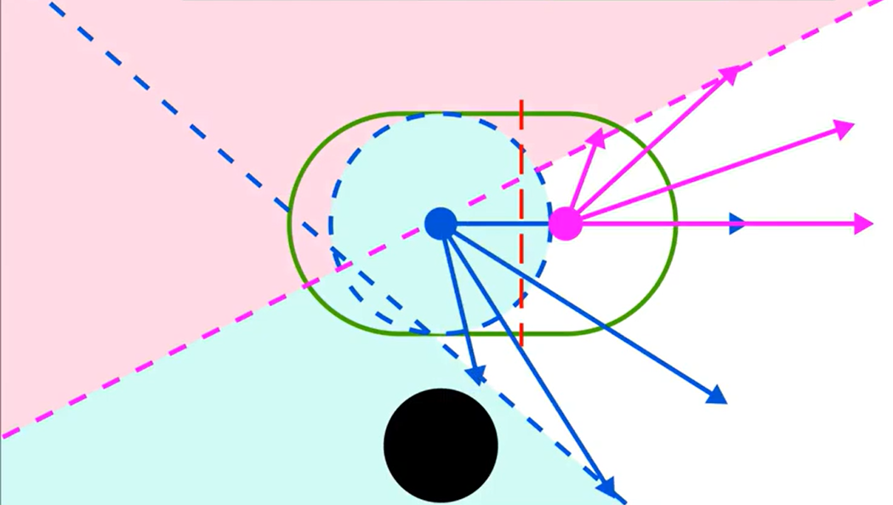
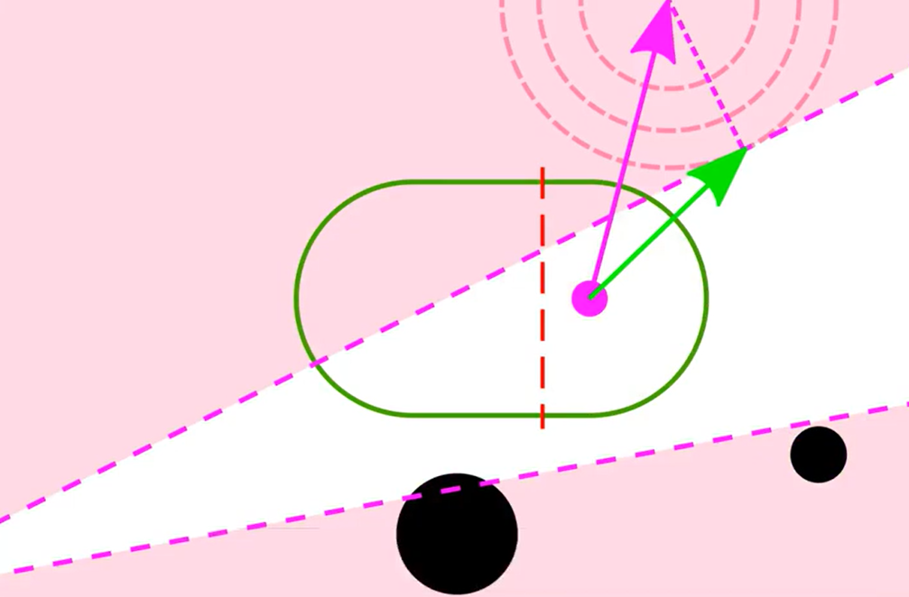
Review
Reactive Driving Support (RDS)
  Using capsule model to describe the robot’s shape
  Model accounts for non-holonomic kinematics preventing sideways motions
Scalable Graphics, Vision & Robotics Lab
Notes:
Before getting deeper, I’ll briefly review about Reactive Navigation in Crowds for Non-holonomic Robots with Convex Bounding Shape which 지혁 presented last time. This paper tried to solve navigating through the crowd for robots with non-holonomic constraints. By considering the velocity obstacle and non-holonomic constraints they were able to avoid collision without getting too far off from the pre-defined path.

Slide 3
Efficient Learning of Goal-Oriented Push-Grasping Synergy in Clutter
2021 RAL
23.11.06 1st Paper Presentation
20234450 Seokryun Choi
Scalable Graphics, Vision & Robotics Lab
Notes:
Back to the main content. Before moving on I’d like to stress the title one more time.

Slide 4
Contents
Overview
Background
Method
Result
Conclusion
Quiz
Scalable Graphics, Vision & Robotics Lab
Notes:
Ok let’s move on. These are the contents of today’s presentation.

Slide 5
Overview
Focused on the task of goal-oriented grasping
  Pre-assigned goal object in clutter
  Pre-grasp actions needed to enable stable grasps
Scalable Graphics, Vision & Robotics Lab
Notes:
This paper focused on the task of goal-oriented grasping, where a pre-assigned goal object is in a clutter so that pre-grasp actions are needed. As you can see in the figure, the goal object, blue cube is denoted with a red star which is impossible to grasp without pushing neighboring cubes to make a room. After pushing nearby objects to remove the clutter, goal object is graspable.

Slide 6
Overview
Reward delay problem
  Gets reward only when successfully grasp the goal object
  Joint pushing and grasping elongates action sequence
2 Methods to sample more efficiently
  Goal relabeling to enrich the replay buffer
  Regard pushing and grasping policies as a generator and a discriminator respectively
Scalable Graphics, Vision & Robotics Lab
Notes:
In this task there’s a problem of reward delay since the robot gets positive reward only when it successfully grasps the goal object. In addition, joint pushing and grasping elongates the action sequence, resulting in more delay. Thus the authors focused on improving sample efficiency. They used two methods to improve sample efficiency. First, they relabeled goal to enrich the replay buffer. When the robot grasped a wrong object they don’t simply regard it as a failure, yet re-set the grasped object as a goal. Second, they regarded pushing and grasping policies as a generator and a discriminator. Training the pushing policy with supervision of grasping discriminator densified pushing rewards. I’ll explain the details in the method section.

Slide 7
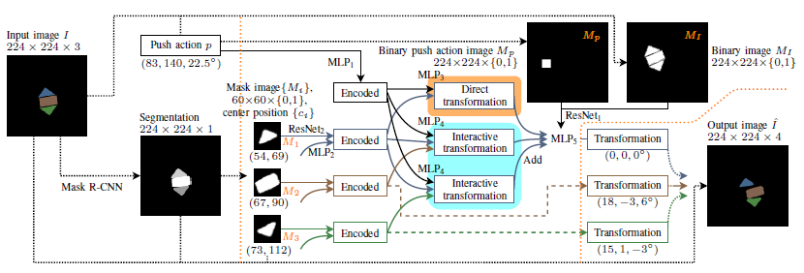
Background
B. Huang, et al. “Dipn: Deep interaction prediction network with application to clutter removal,” in IEEE International Conference on Robotics and Automation, 2021
Scalable Graphics, Vision & Robotics Lab
Notes:
There were several works establishing the learning strategies to develop synergies between pushing and grasping. However many works were only applicable to goal-agnostic tasks, unable to designate what to grasp.
A few works presented a goal-oriented method but relied on 3D model or needed handcraft push reward to densify the reward. This approach was hard to fully represent the interactions and lacked generalizability. To overcome such problem, this paper used a data driven reward which can optimize itself.

Slide 8
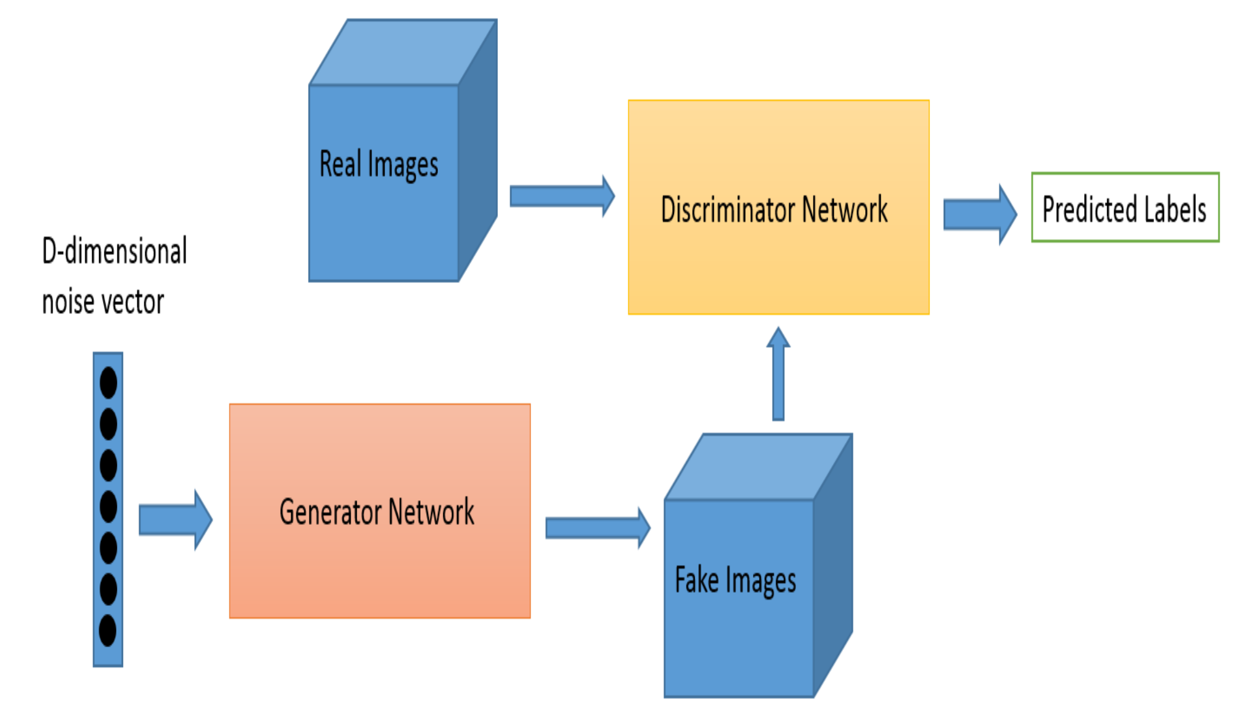
Background
GAN(Generative Adversarial Network)
https://pseudo-lab.github.io/Tutorial-Book/chapters/GAN/Ch1-Introduction.html
Scalable Graphics, Vision & Robotics Lab
Notes:
Next, to understand how this paper trained their network, let’s briefly look at GAN. GAN is a generative model which uses two networks, generator and discriminator. From a noise vector, generator generates fake image and discriminator classifies if it is real or not. Through training, both the generator and the discriminator gets smarter and smarter, trying to outsmart one another.

Slide 9
Method
Goal-conditioned grasping training
Goal-conditioned pushing training
Alternating training
Scalable Graphics, Vision & Robotics Lab
Notes:
Next let’s look at how it is trained. The whole framework is trained in 3 steps. First the grasping policy is trained in a relatively scattered environment. Next pushing policy is trained. With the fixed grasp net, pushing is evaluated. If the graspable probability is improved, the robot is given a pushing reward. After these two stages the grasp net and push net have a distribution mismatch problem since the grasp net is trained in a relatively scattered environment. To relieve this, alternating training is deployed which is really similar to training GAN.

Slide 10
Method
Relabeling : if successfully grasped an object that’s not a goal, relabel the goal of corresponding experience in the replay buffer -> improved sample efficiency
Scalable Graphics, Vision & Robotics Lab
Notes:
In the training phase the authors used goal relabeling to improve sample efficiency. During an episode, when the robot grasps an object that’s not a goal it relabels the goal of corresponding experience in the replay buffer which makes the wrong decision beneficial.

Slide 11


Method
Scalable Graphics, Vision & Robotics Lab
Notes:
In the second stage, the pushing reward is formulated in this way. If the pushing improves the Q value of best grasp more than 0.1 and change is detected, the robot is given a reward of 0.5. Here by change means, if the occupancy surrounding the goal object is decreased more than 0.1. If there is no change after pushing, the robot is given a negative 0.5 since it should be avoided to meaninglessly increase the number of actions.

Slide 12
Method
Alternating training
  Relieves the mismatch between grasping policy and pushing policy
  Grasping policy learns to perform better in cluttered scene
Scalable Graphics, Vision & Robotics Lab
Notes:
The last stage is alternating training. By training in a more cluttered scene than the first stage, grasping policy achieves a better performance in cluttered scene. Since the pushing policy was trained in a cluttered environment in the second stage, it is only trained for the half of the episodes than the grasping policy.

Slide 13
Method
Scalable Graphics, Vision & Robotics Lab
Notes:
This is the overall framework. Fixed camera captures the rgb and depth of the scene, which is then projected to a gravity direction. From this height maps and goal object mask, the grasp net evaluates if goal object is graspable. If not, push net generates a best push to make goal object more graspable.

Slide 14
Result
1) Is it capable of speeding up the training process
2) Is it effective with unseen and challenging arrangements
3) Is it able to extend to goal-agnostic conditions
4) Is it able to transfer from simulation to real world w/o fine tuning
Scalable Graphics, Vision & Robotics Lab
Notes:
With series of experiments they tried to show 4 things. One~

Slide 15

Result
Scalable Graphics, Vision & Robotics Lab
Notes:
In the first stage, after ~

Slide 16
Result
ㅁ
Scalable Graphics, Vision & Robotics Lab
Notes:
As you can see in the figure, this method reaches 80 % grasp success rate in less training episodes than any other baselines.

Slide 17

Result
ㅁ
Scalable Graphics, Vision & Robotics Lab
Notes:
These are some challenging cases where pushing is necessary.

Slide 18
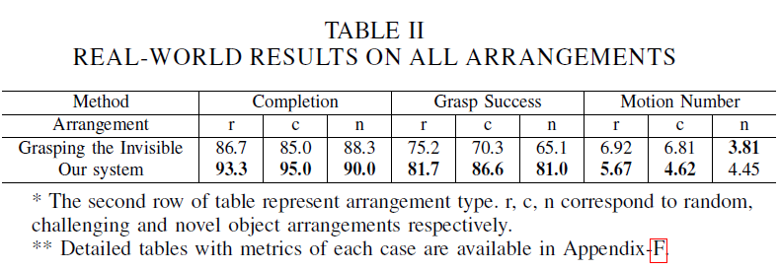
Result
Scalable Graphics, Vision & Robotics Lab
Notes:
With random, challenging, and novel object arrangements, proposed method outperformed the baseline in almost every cases.

Slide 19
Result
Scalable Graphics, Vision & Robotics Lab
Notes:
The proposed method achieved better completion and grasp success than the baseline even in a goal agnostic condition.

Slide 20

Result
Scalable Graphics, Vision & Robotics Lab
Notes:
The simulation to real world transfer was also successful without fine tuning.

Slide 21
Conclusion
Sped up the training process
Capable of generalizing from simulation to real-world
Also achieves a good performance on goal-agnostic condition
Scalable Graphics, Vision & Robotics Lab

Slide 22
Quiz
1. This paper brought the concept from a renowned generative model for training. What is this model called?
2. There were 4 components from the title which I stressed throughout the presentation. Which one is not that component?
  A. Efficient learning
  B. Goal agnostic
  C. Push-grasping
  D. In clutter
Scalable Graphics, Vision & Robotics Lab

